Slide 1

Place additional text if needed here
A guide for ASU presentations
including tips on how to say more with less

Slide 2
Colors
Data
Images
Charts
Preview your main points

Slide 3
Part I: Knowing the ASU color palette

Slide 4
The color palette
R 140 G 29 B 64 #8C1D40
R 255 G 198 B 39 #FFC627
R 92 G 102 B 112 #5C6670
R 255 G 255 B 255
R 0 G 0 B 0
The ASU colors have been programed in the color picker pull-down menu.
Select no more than two or three colors to use per slide to avoid making your slide look like a rainbow…a very ugly ASU rainbow.

Slide 5
Part II: Slides that have data and main points

Slide 6
Avoid bullet points; instead, aim for one point per slide.

Slide 7
Seems odd; but, trust me—I know what I’m doing here.
“If you absolutely must have two things on one slide (e.g., a point and a quote), remember to place one of those in a space like this that will draw your audience’s attention.” – Aristotle

Slide 8
You might end up with five times as many slides as you would otherwise.
“But that is perfectly OK because your slides are simpler and you will move through them quicker.” – Barack Obama

Slide 9
Over 90 percent of college students agree…

Slide 10
…slides with less text on them actually say more.

Slide 11
Use text color to emphasize an important point.

Slide 12
You may also use a box like this to emphasize an important point.

Slide 13
Be sure to use Arial, it is ASU brand approved and standard on both PCs and Macs.

Slide 14
100
percentage of audience members who are engaged by PowerPoint presentations that are clear and simple

Slide 15
25
percentage of all audience members who would rather write a dissertation than watch a presentation with 5+ bullet points per slide
2
number of times audience members will fall asleep during a PowerPoint presentation that has 5+ bullet points per slide

Slide 16
Part III: Slides that use images

Slide 17

For the most dramatic effect, use no more than one image per slide.

Slide 18

Use large, high-quality images (images that do not become blurry, fuzzy or pixelated when enlarged on a PowerPoint slide).

Slide 19
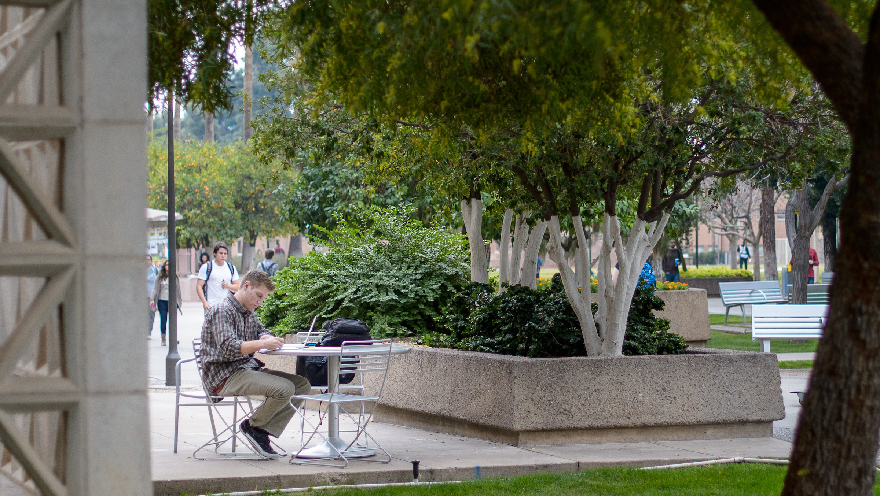
To resize an image, always use the resizing tool on an image’s corner (versus its side); this prevents the image from having a “stretched” appearance.

Slide 20

You may download ASU images for your unit’s print and electronic needs from asu.photoshelter.com. Please email andy.delisle@asu.edu to request access.

Slide 21
Part IV: Slides that use charts

Slide 22
Sometimes you will need to represent ideas in the form of a chart or graph.

Slide 23
For the greatest impact, use the simplest possible representation; for example…

Slide 24
Use shapes and ASU colors
^{94%}
^{78%}
Rated experience good or enjoyable
^{Will return}

Slide 25
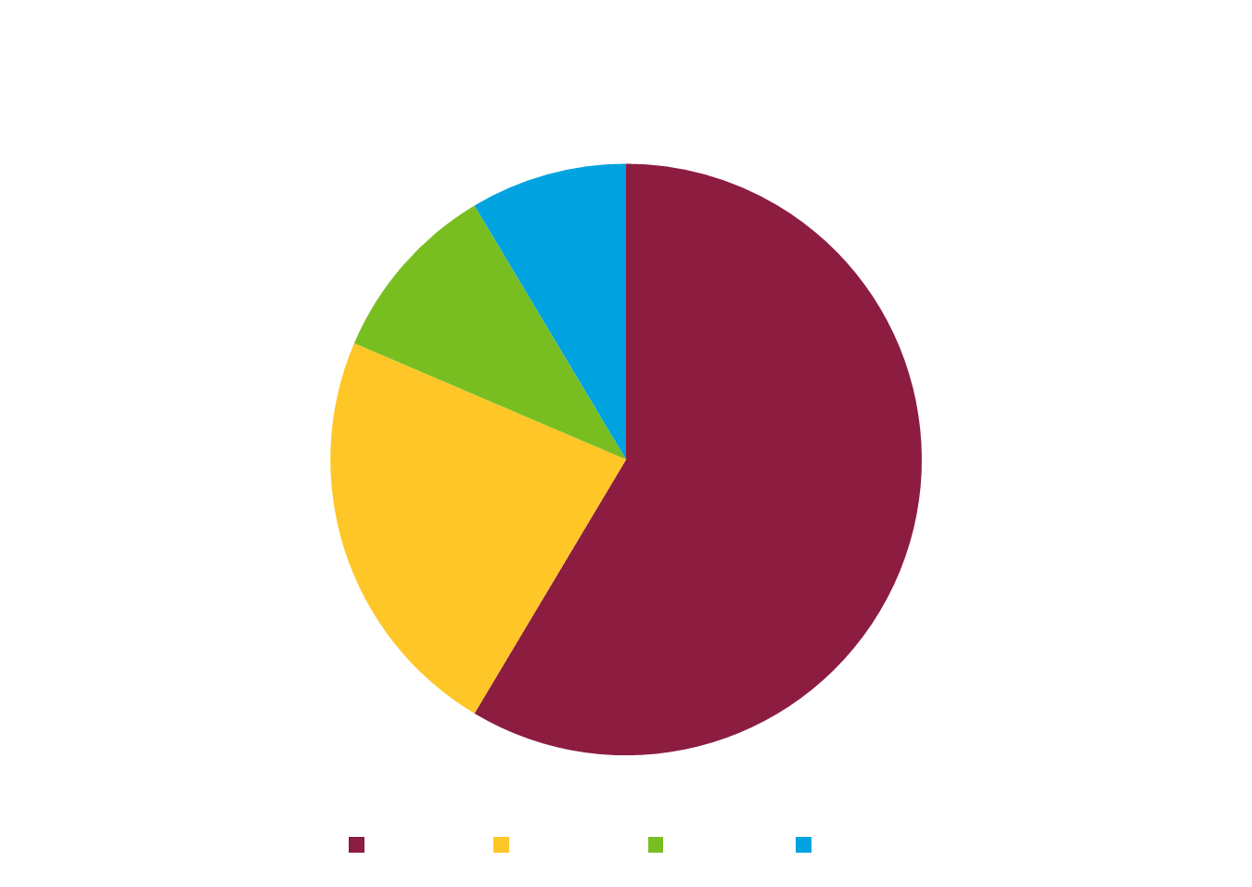

Slide 26
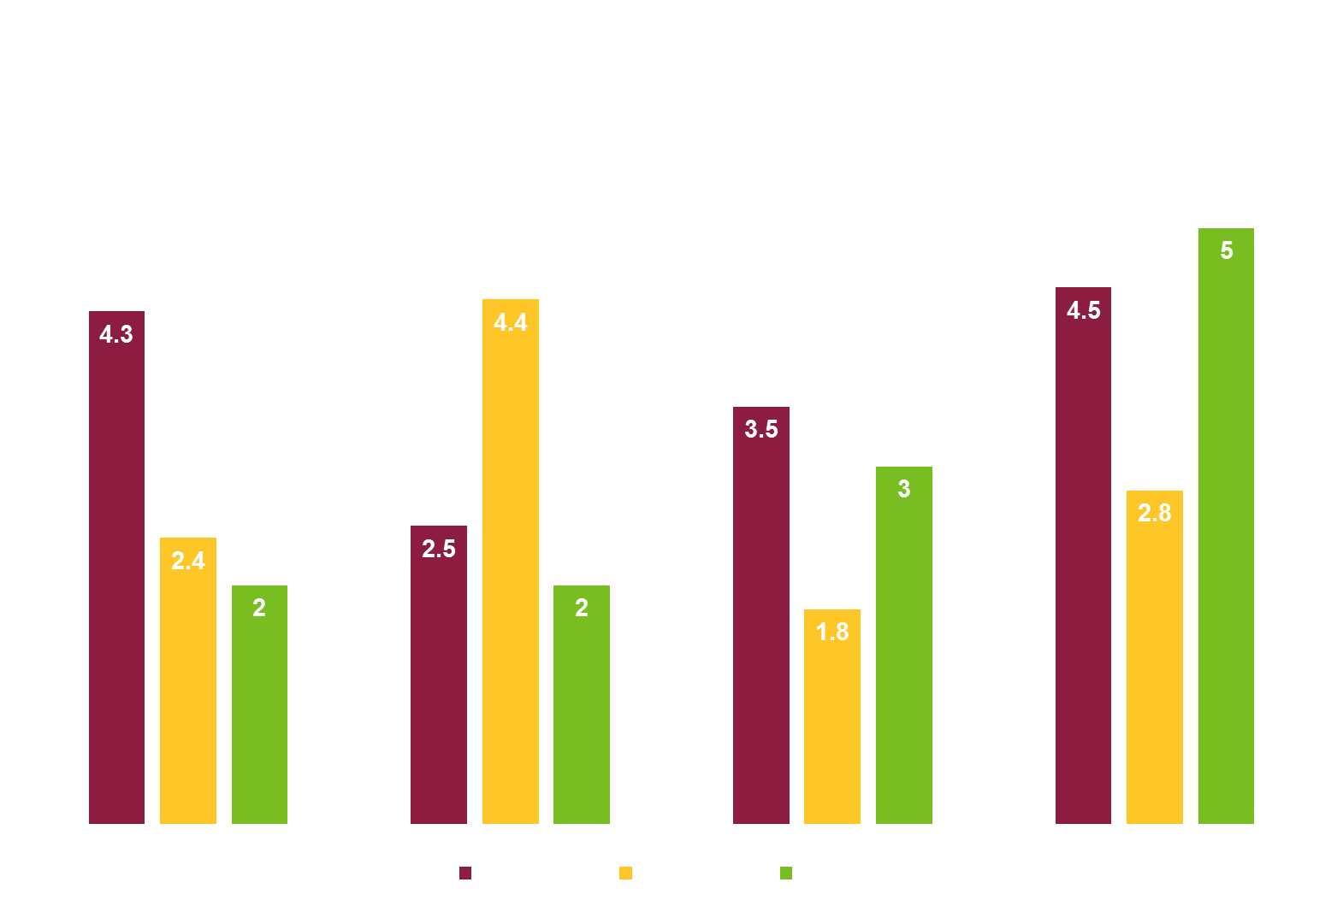

Slide 28
solutions-oriented
entrepreneurial
impact
decisive
access
a New American University
visionary
excellence
bold
create
imaginative
re-envision

Slide 29
Colors
Data
Images
Charts
Restate your main points

Slide 30
Thank you!
Contact info or website url here

